Slide 1

Algebra 1
Unit 4, Lesson 1 Understanding Set-Builder Notation Volume 1, pg. 163

Slide 2


Benchmark
MA.912.F.1.5
Compare key features of linear functions each represented algebraically, graphically, in tables or written descriptions.
volume 1, pg. 163

Slide 3
Integrated Mathematical Thinking and Reasoning Standards
MA.K12.MTR.1.1 Actively participate in effortful learning both individually and collectively.
MA.K12.MTR.2.1 Demonstrate understanding by representing problems in multiple ways.
MA.K12.MTR.4.1 Engage in discussions that reflect on the mathematical thinking of self and others.
MA.K12.MTR.5.1 Use patterns and structure to help understand and connect mathematical concepts.
volume 1, pg. 163

Slide 4

Learning Targets
I can understand the domain and range of a linear relationship.
I can write inequalities using set-builder notation.
volume 1, pg. 163

Slide 5

Warm-Up
volume 1, pg. 163

Slide 6

4.1.1 Warm-Up: What is Infinity?
In Toy Story, Buzz Lightyear uses the phrase “To infinity and beyond.” But what does it mean to go beyond infinity? Infinity is an elusive concept that can often be difficult to comprehend. Eugenia Cheng, a mathematician, explains infinity as “not a normal kind of number.” Eugenia uses set theory to explain infinity. She uses the idea of a bag as a set. By placing a bag in a bag, there is a bag with one thing. Infinity can be illustrated by adding more and more bags and each bag contains other bags. Because you can keep adding bags with no end, the set contains an infinite number of bags.
volume 1, pg. 163
Notes:
Video Link: https://algebranation.wistia.com/medias/fi4fidi5y8

Slide 7
Explain briefly your understanding of infinity.
In the video, Eugenia Cheng uses the word paradox. A paradox is a seemingly absurd or self-contradictory statement that when investigated may prove to be well‑founded, or true. Why do you think the idea of infinity can create a paradox?
volume 1, pg. 163

Slide 8

The symbol for infinity is $∞$. The infinity symbol was first used by John Wallis in 1655. Draw an infinity symbol without picking your writing utensil up from the paper.
How many times can you trace over the infinity symbol without picking up your writing utensil from the paper?
volume 1, pg. 164

Slide 9

Collaboration
volume 1, pg. 164

Slide 10

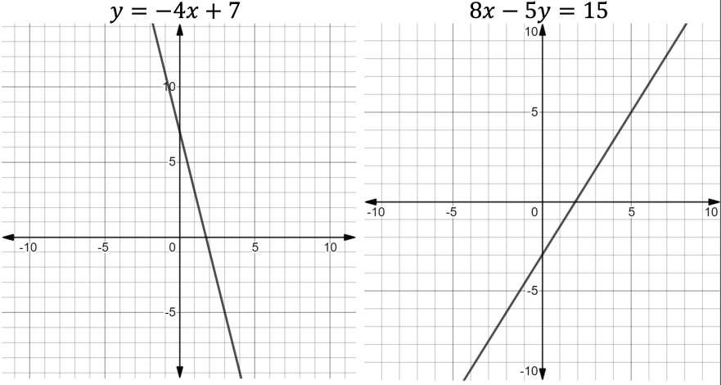


4.1.2 Collaboration: Domain and Range of Linear Relationships
The graphs of $y=−4x+7$and $8x−5y=15$are shown.
The graphs of $y=−4x+7$and $8x−5y=15$are lines.
A line is a straight path that extends infinitely in both directions.
volume 1, pg. 164

Slide 11

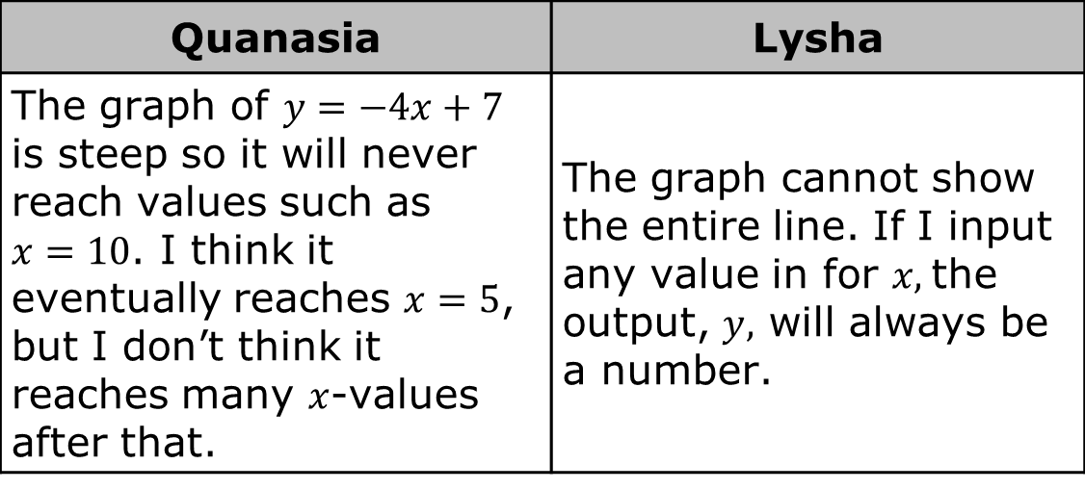
Two students were discussing how to determine if there is an 𝑥-value(s) not included in the graph of $y=−4x+7$. Their explanations are shown.
Discuss with your partner the two different explanations. Then, use the definition of a line to justify whether there is an 𝑥-value(s) not included in the graph of the line $y=−4x+7$.
Quanasia | Lysha
The graph of $y=−4x+7$ is steep so it will never reach values such as $x=10$. I think it eventually reaches $x=5$, but I don’t think it reaches many $x$-values after that. | The graph cannot show the entire line. If I input any value in for $x,$the output, $y,$ will always be a number.
volume 1, pg. 165

Slide 12
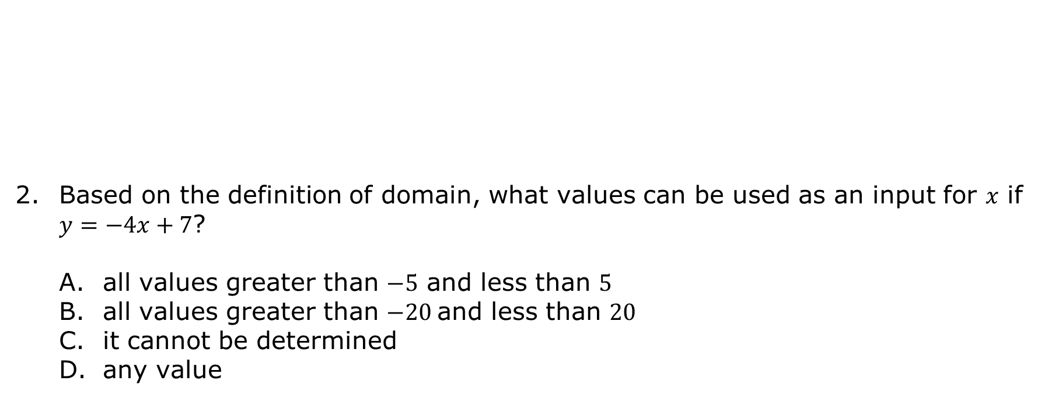
The domain is the complete set of possible values of the input of a function or relation. The domain may vary depending on the context.
Based on the definition of domain, what values can be used as an input for 𝑥 if $y=−4x+7$?
all values greater than $−5$ and less than $5$
all values greater than $−20$and less than $20$
it cannot be determined
any value
volume 1, pg. 165

Slide 13
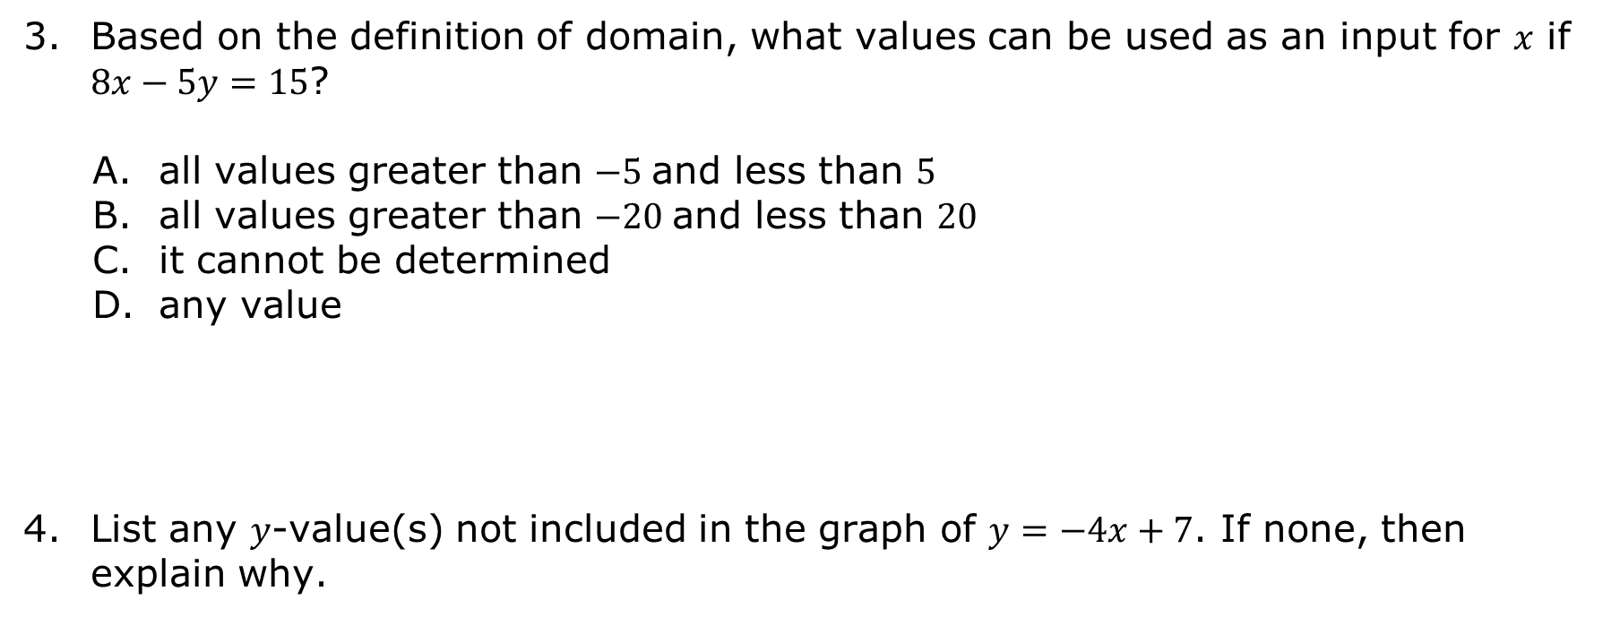
Based on the definition of domain, what values can be used as an input for 𝑥 if $8x−5y=15$?
all values greater than $−5$and less than $5$
all values greater than $−20$and less than $20$
it cannot be determined
any value
List any 𝑦-value(s) not included in the graph of $y=−4x+7$. If none, then explain why.
volume 1, pg. 165

Slide 14
List any 𝑦-value(s) not included in the graph of $8x−5y=15$. If none, then explain why.
The range is the complete set of possible values of the output of a relation or function.
volume 1, pg. 165

Slide 15
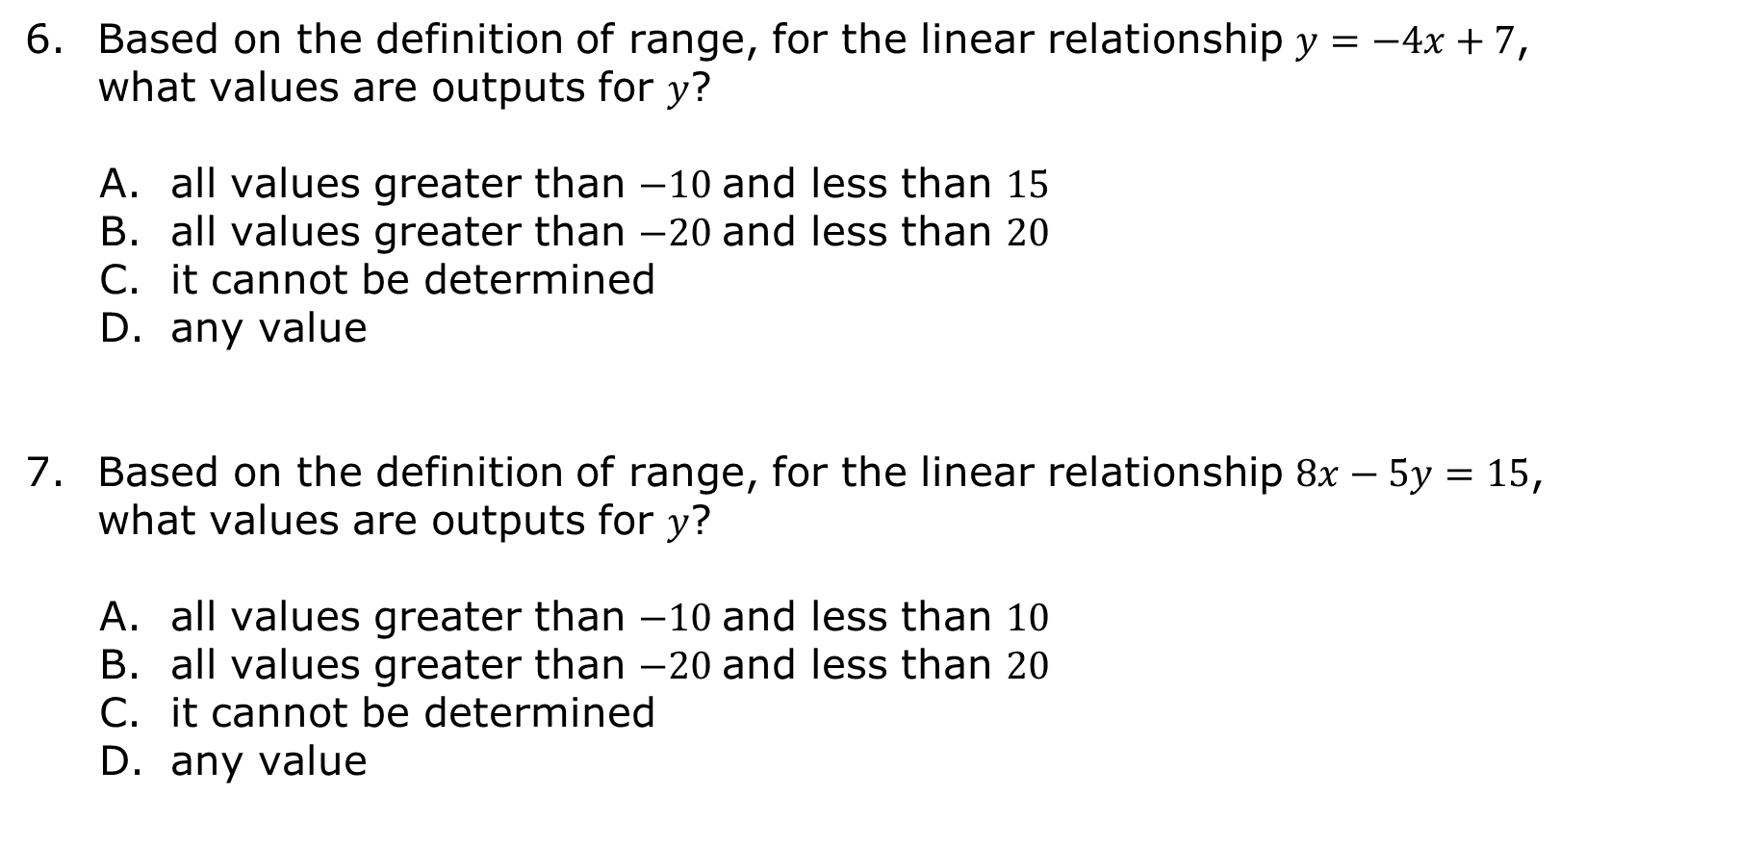
Based on the definition of range, for the linear relationship $y=−4x+7$, what values are outputs for 𝑦?
all values greater than $−10$and less than $15$
all values greater than $−20$and less than $20$
it cannot be determined
any value
Based on the definition of range, for the linear relationship $8x−5y=15$, what values are outputs for 𝑦?
all values greater than $−10$and less than $10$
all values greater than $−20$and less than $20$
it cannot be determined
any value
volume 1, pg. 166

Slide 16

Guided Instruction
volume 1, pg. 166

Slide 17

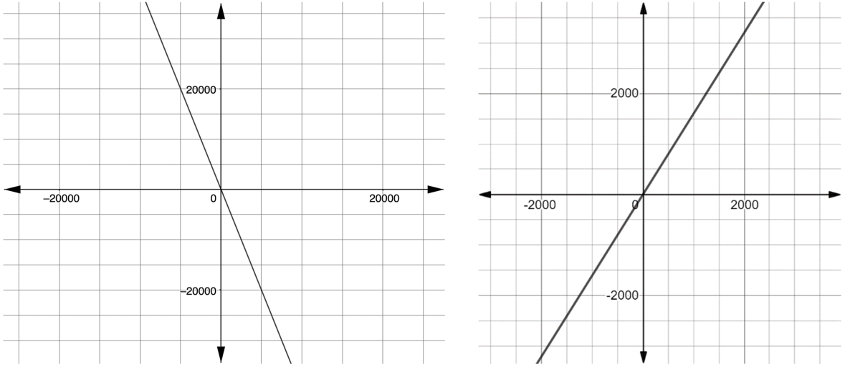

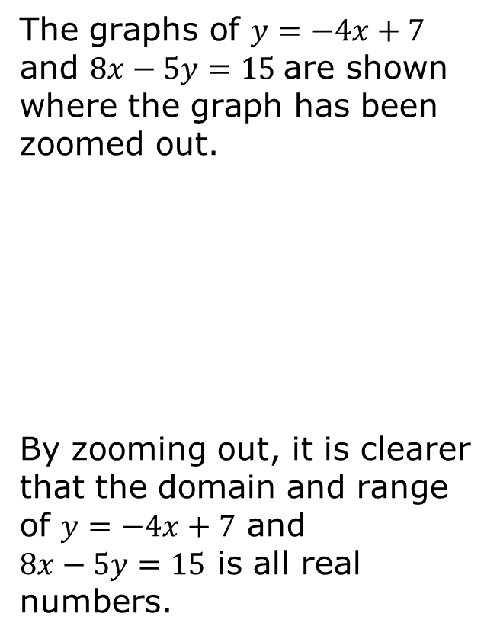


4.1.3 Guided Instruction: Set-Builder Notation
The graphs of $y=−4x+7$ and $8x−5y=15$are shown where the graph has been zoomed out.
By zooming out, it is clearer that the domain and range of $y=−4x+7$ and
$8x−5y=15$ is all real numbers.
$$y=−4x+7$$
$$8x−5y=15$$
The domain and range of a linear relationship are all real numbers.
volume 1, pg. 166

Slide 18
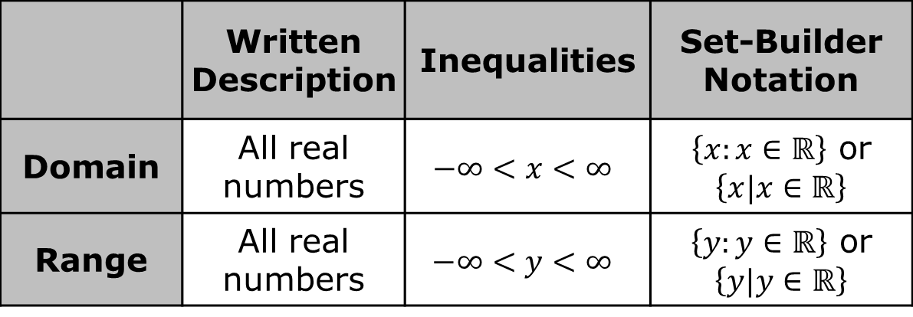
There are several ways to mathematically represent the domain and range of all real numbers.
The representation of the domain using inequalities is read as, “negative infinity is less than 𝑥, which is less than infinity.”
 | Written Description | Inequalities | Set-Builder Notation
Domain | All real numbers | $$−∞<x<∞$$ | $\left\{x:x∈ℝ\right\}$ or $\left\{x|x∈ℝ\right\}$
Range | All real numbers | $$−∞<y<∞$$ | $\left\{y:y∈ℝ\right\}$ or $\left\{y|y∈ℝ\right\}$
volume 1, pg. 167

Slide 19
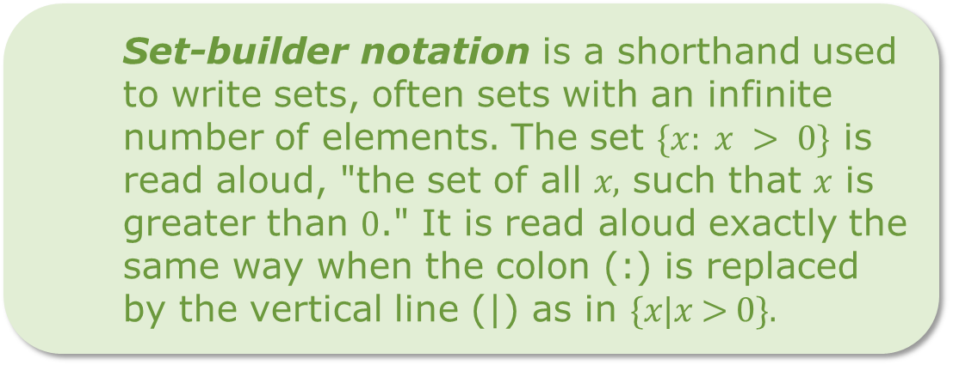
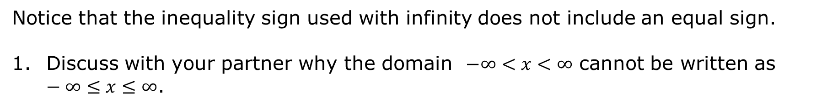
Notice that the inequality sign used with infinity does not include an equal sign.
Discuss with your partner why the domain $−∞<x<∞$ cannot be written as $−∞≤x≤∞$.
Set-builder notation is a shorthand used to write sets, often sets with an infinite number of elements. The set $\{x: x > 0\}$ is read aloud, "the set of all 𝑥, such that 𝑥 is greater than 0." It is read aloud exactly the same way when the colon (:) is replaced by the vertical line (|) as in {𝑥|𝑥 > 0}.
volume 1, pg. 167

Slide 20
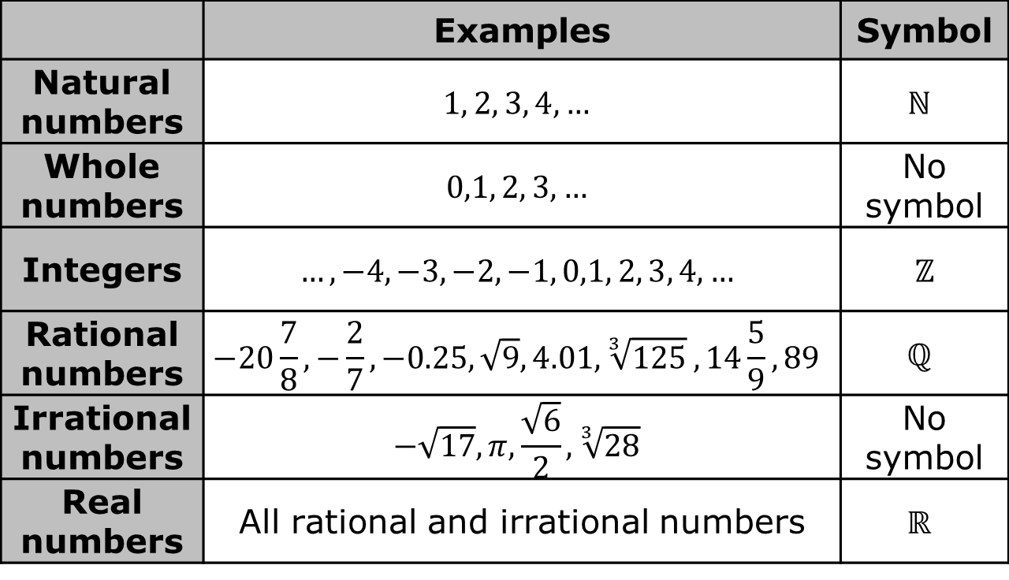
The table shows number sets within the number system, examples of the types of numbers included in each set, and the symbol used in set-builder notation, if there is one.
 | Examples | Symbol
Natural numbers | $$1, 2, 3, 4,…$$ | $$ℕ$$
Whole numbers | $$0,1, 2, 3, …$$ | No symbol
Integers | $$…,−4, −3, −2, −1, 0,1, 2, 3, 4,…$$ | $ℤ$
Rational numbers | $$−20\frac{7}{8},−\frac{2}{7}, −0.25,\sqrt{9},4.01,\sqrt[3]{125} ,14\frac{5}{9},89$$ | $$ℚ$$
Irrational numbers | $$−\sqrt{17}, π, \frac{\sqrt{6}}{2},\sqrt[3]{28}$$ | No symbol
Real numbers | All rational and irrational numbers | $$ℝ$$
volume 1, pg. 167

Slide 21
In most cases, set-builder notation is similar to an inequality, except when referring to a number system or a specific pattern of numbers.
volume 1, pg. 167

Slide 22
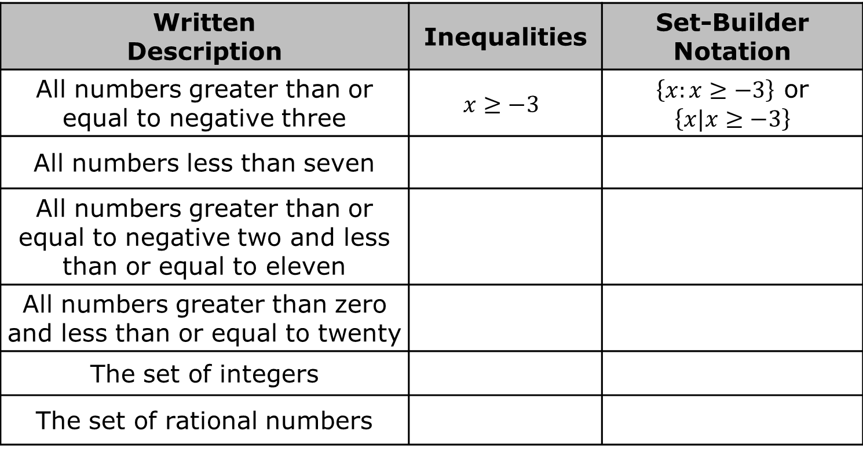
Work with your partner to complete the table. The first row has been completed.
Written Description | Inequalities | Set-Builder Notation
All numbers greater than or equal to negative three | $$x≥−3$$ | $\left\{x:x≥−3\right\}$ or $$\left\{x|x≥−3\right\}$$
All numbers less than seven
All numbers greater than or equal to negative two and less than or equal to eleven
All numbers greater than zero and less than or equal to twenty
The set of integers
The set of rational numbers
volume 1, pg. 168

Slide 23
Explain why writing the set of integers and the set of rational numbers using inequalities is not possible.
volume 1, pg. 168

Slide 24

Wrap-Up
volume 1, pg. 168

Slide 25
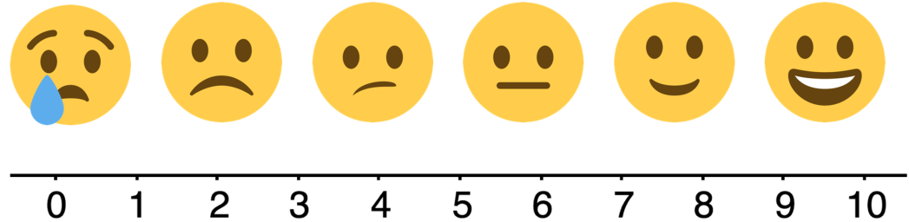
4.1.4 Wrap-Up: Reflection
Use the emoji scale to describe how well you understand the domain and range of a linear relationship.
Use the emoji scale to describe how well you understand set-builder notation.
volume 1, pg. 168

